Slide 1

IEEE PAR 3131
Recommended Practice for Data Engineering with Heterogeneous Ecosystems and Data Sources for Efficient Data Processing, Management, and Consumption
By: Benjamin carpena (@bencarpena)

Slide 2
WHy?
Heterogeneous systems produce varying data formats, variance, velocity, and volume.
Integrating data from diverse ecosystems with rigid pre-cast data structures does not satisfy the agility & requirements of modern data-driven workflows.
Need to automate data acquisitions and product publishing to support the needs of a data-intensive world.
Put more emphasis on using json payloads that adhere to OData standards (RFC7159) during Remote Procedure Invocation (e.g. API-based, microservices-based) integration patterns.

Slide 3
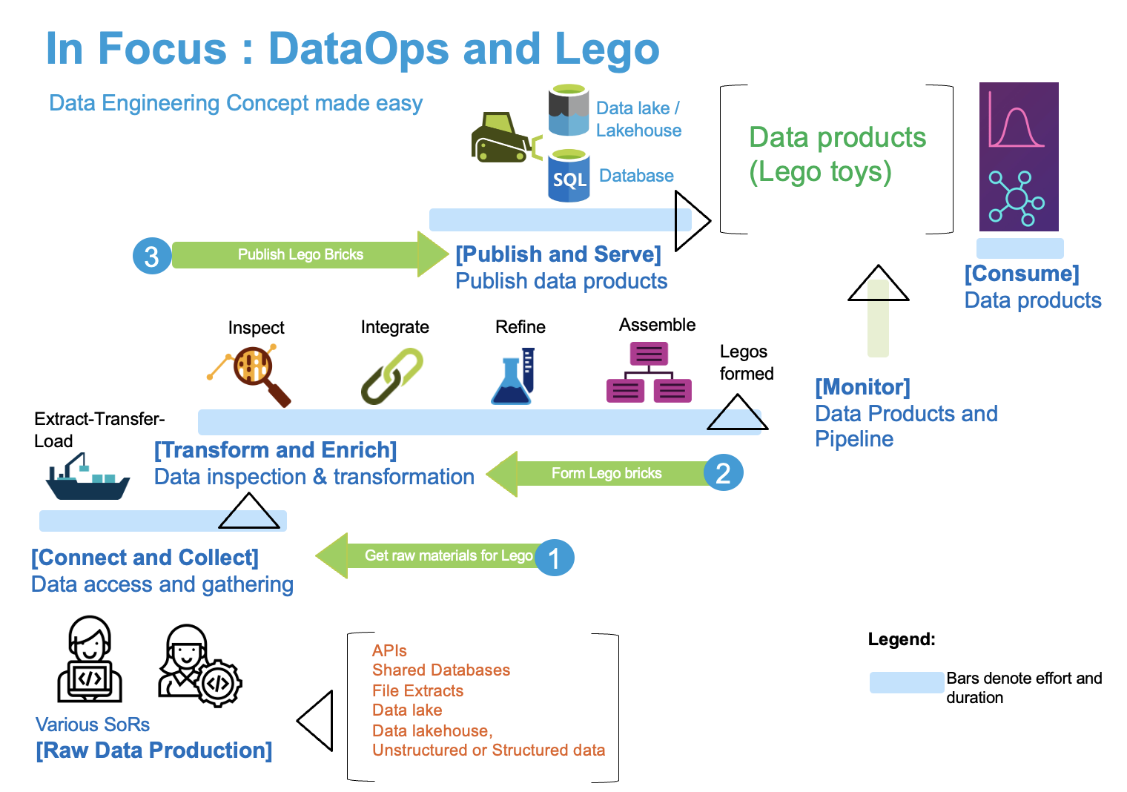


How?

Slide 4
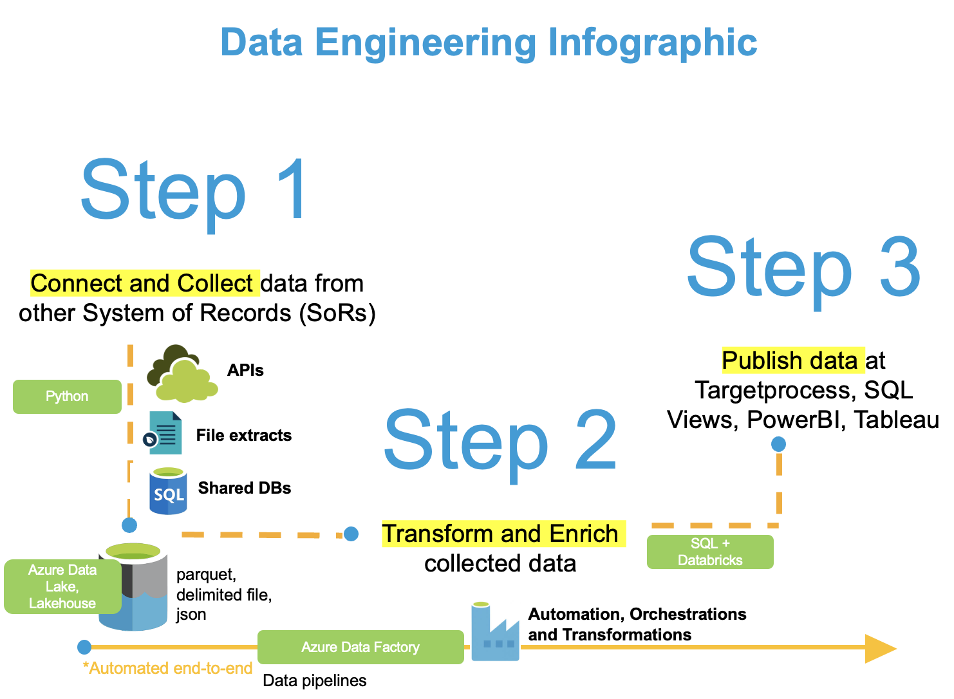
Best practice in action
Proof-is-in-the-pudding
Implementation of best practice for a fortune 500 company

Slide 5

WHAT?
Best practice recommendation that supports simple to complex data workloads
Data Factory with automated data pipelines + workflows capable of ingesting & transforming wrangled raw data
Lego bricks as data products

Slide 6


Recommended practice OUTPUT
A blueprint for producing:
- an automated and agile data pipeline
- data products aiding simple to complex data-driven insights

